Slide 1
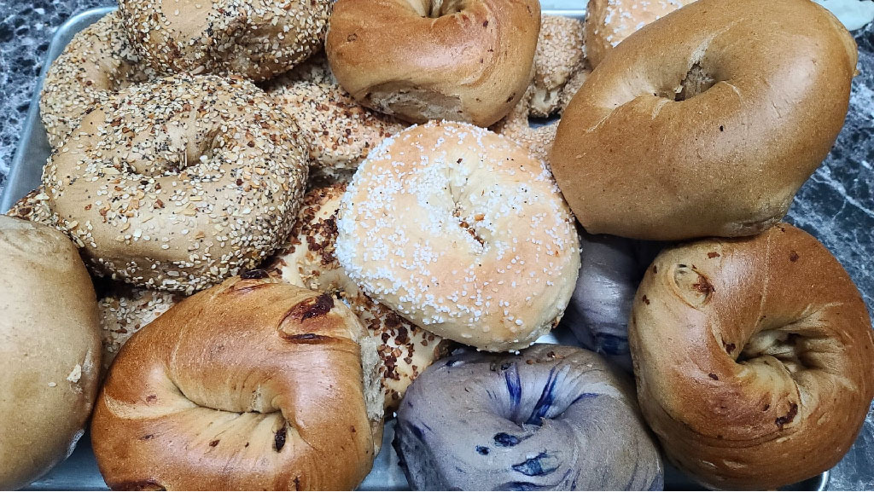
Inwood Bagels
Team 2
Gaelle Giles - Project Manager
Charles Adams - Product Owner
Noah Ponticiello - DBA
Masha Obaturova - Lead Developer
Hemawsi Gorrela - Developer
Nandu Devarasetty - Lead Business Analyst
Abhilash Gubbala - Lead QA Analyst
Brindavani Pathuri - Tester

Slide 2
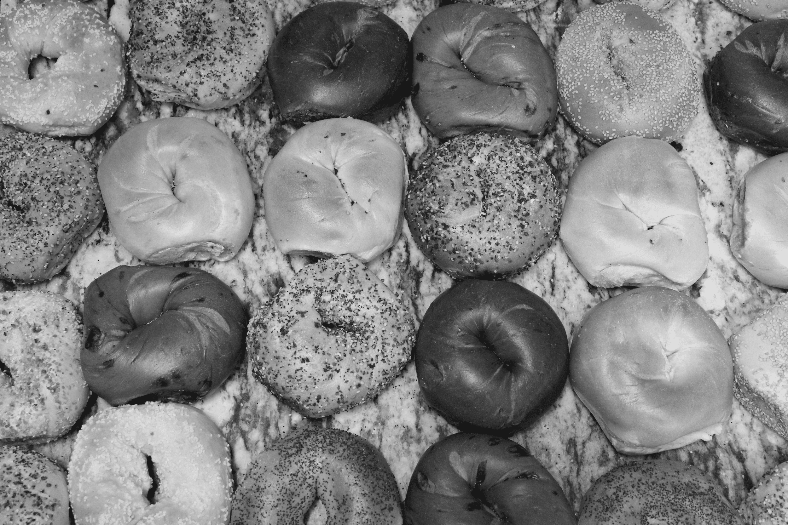
GitHub URL: https://github.com/Team2-Inwood-Bagels

Slide 3
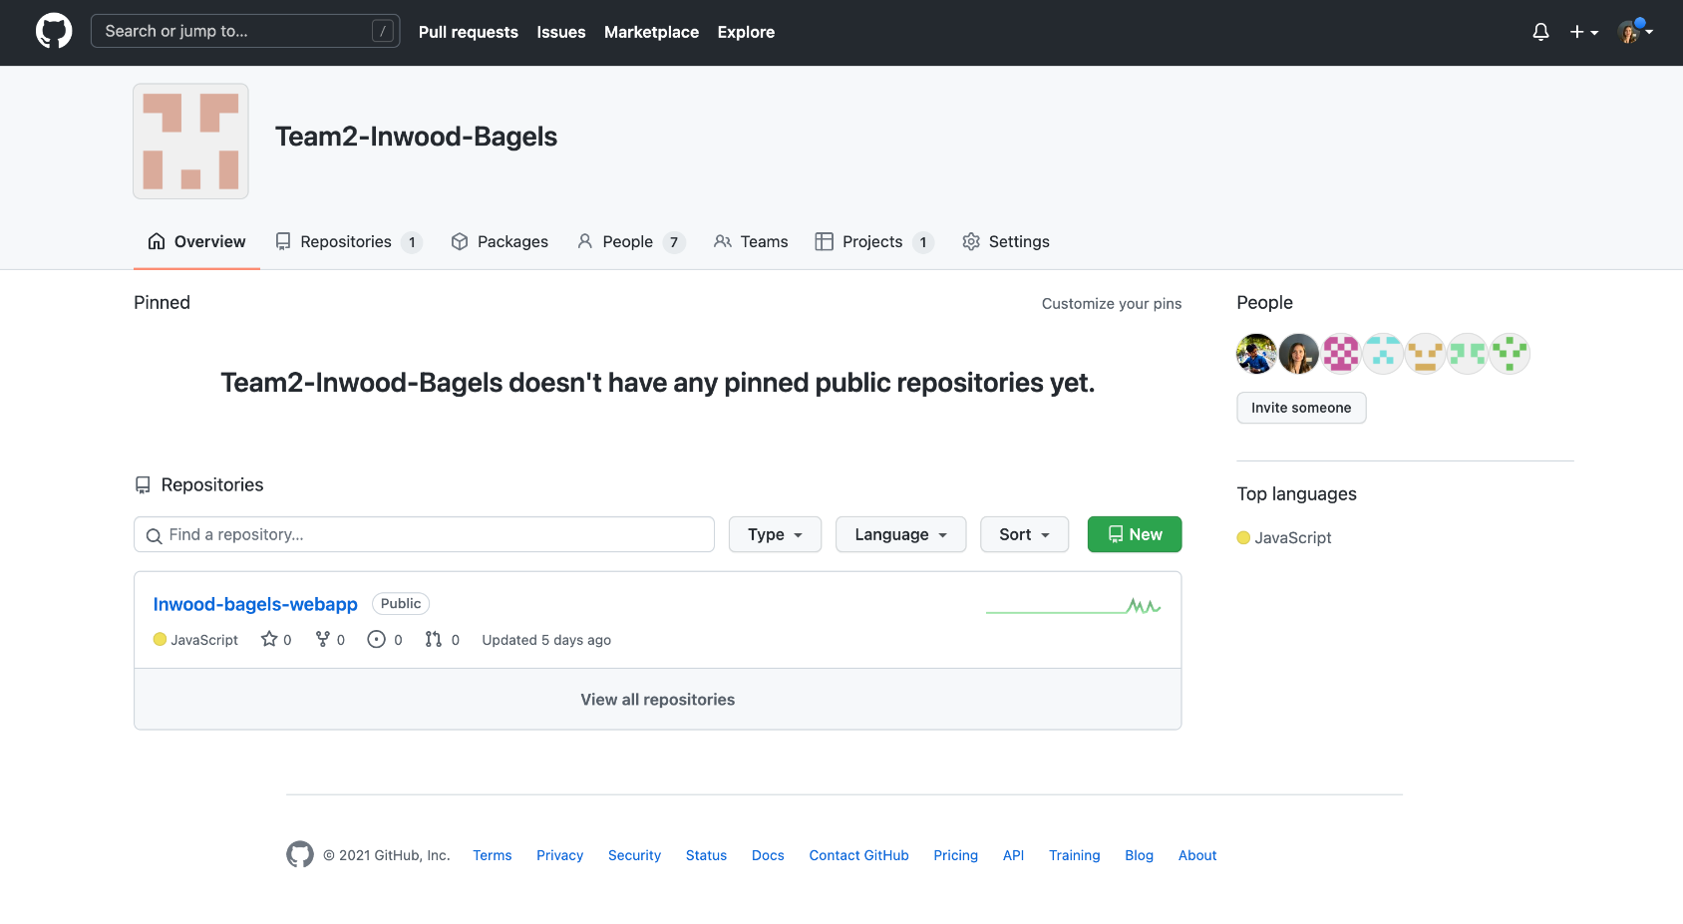
Organization Overview

Slide 4
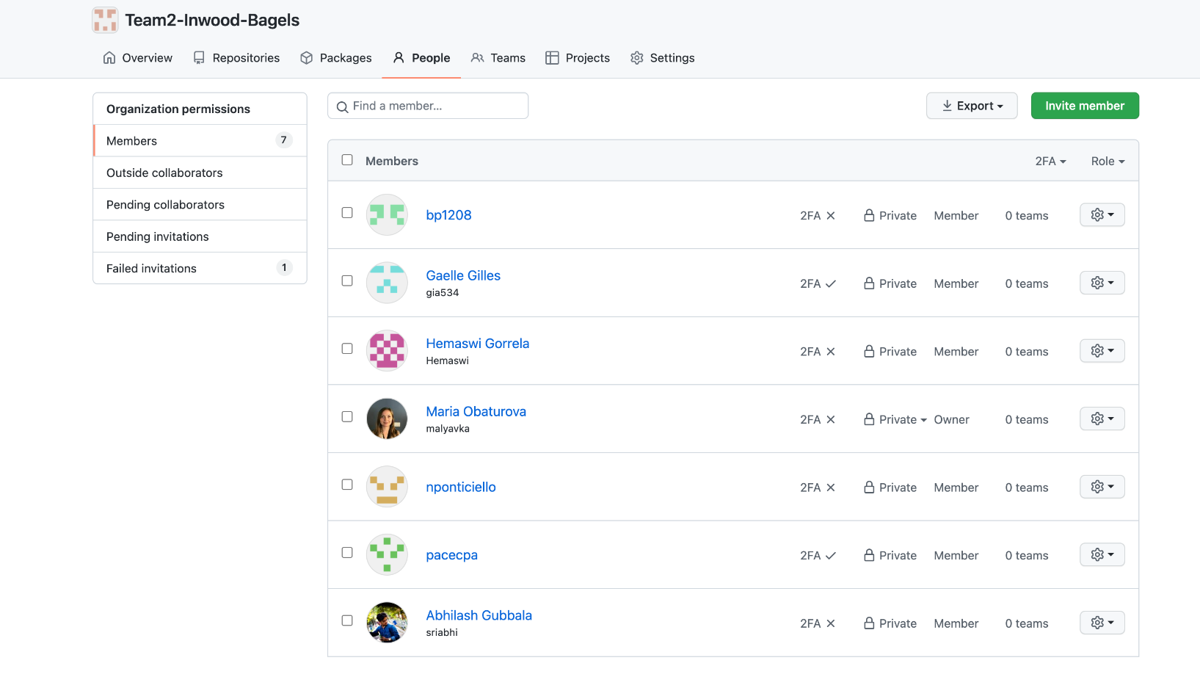
Organization Overview

Slide 5
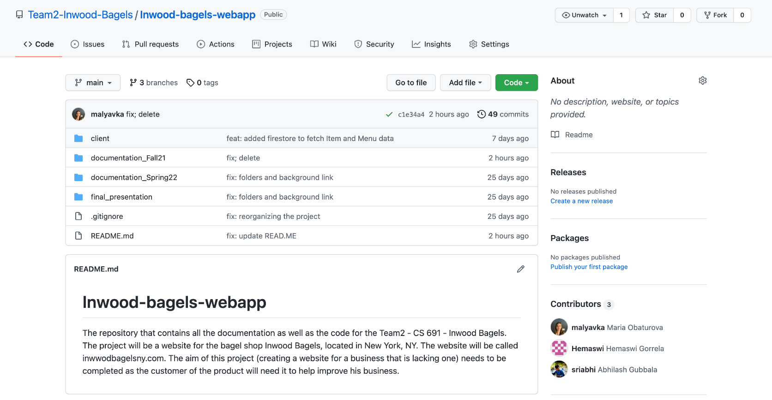
Repository Structure

Slide 6
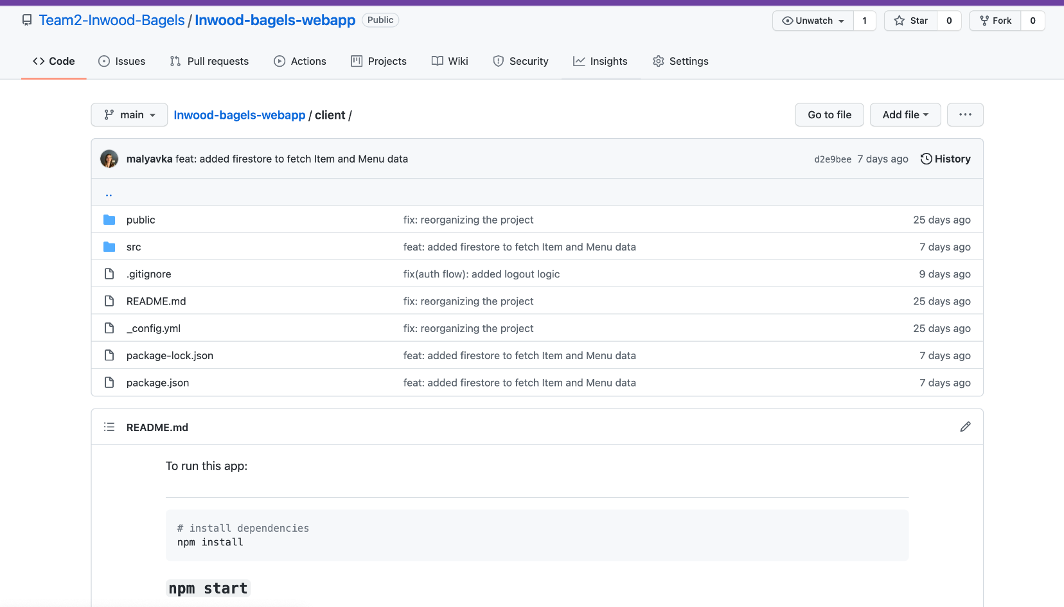
Repository Structure - Client

Slide 7
Build & Run Precedures
Node.js should be installed on the machine
Clone repo from the GitHUB remote repo
Open the Project in the Text Editor of your choice
Be sure to be in a /Client folder
cd Client
Run npm install in the Terminal window
Run npm start in the Terminal window
Open the browser window and http://localhost:3000/

Slide 8
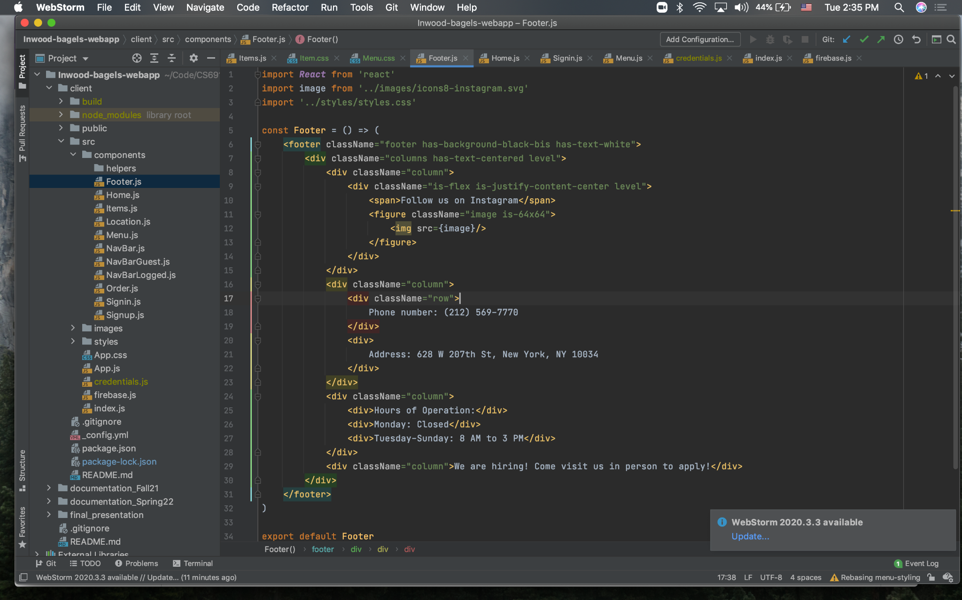
Code Examples

Slide 9
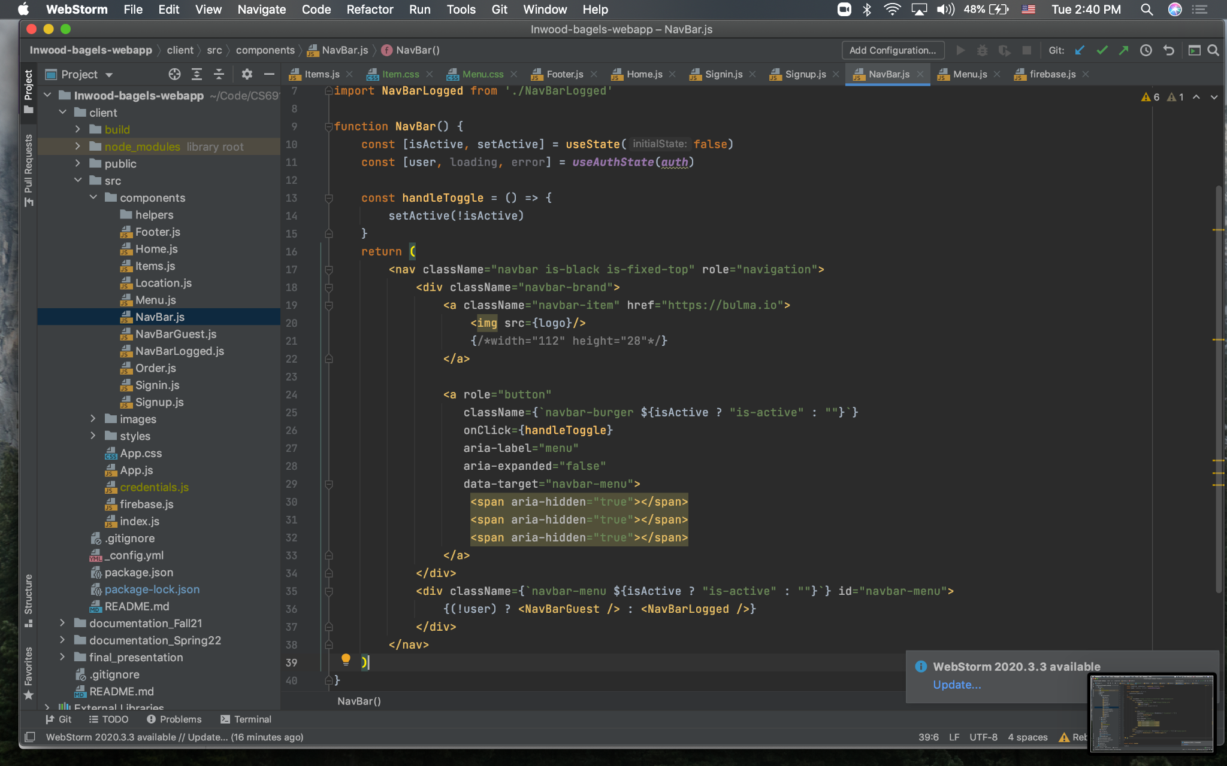
Code Examples

Slide 10
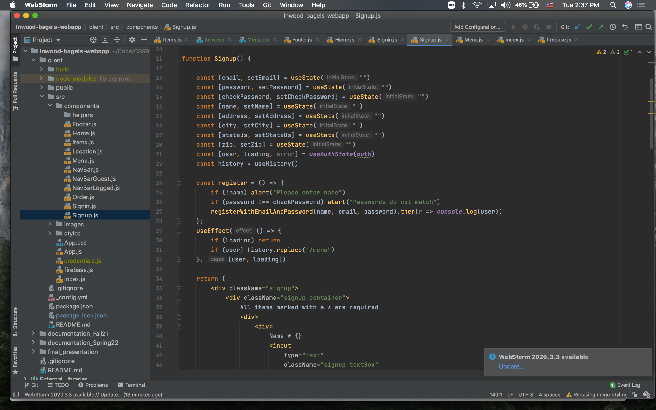
Code Examples

Slide 11
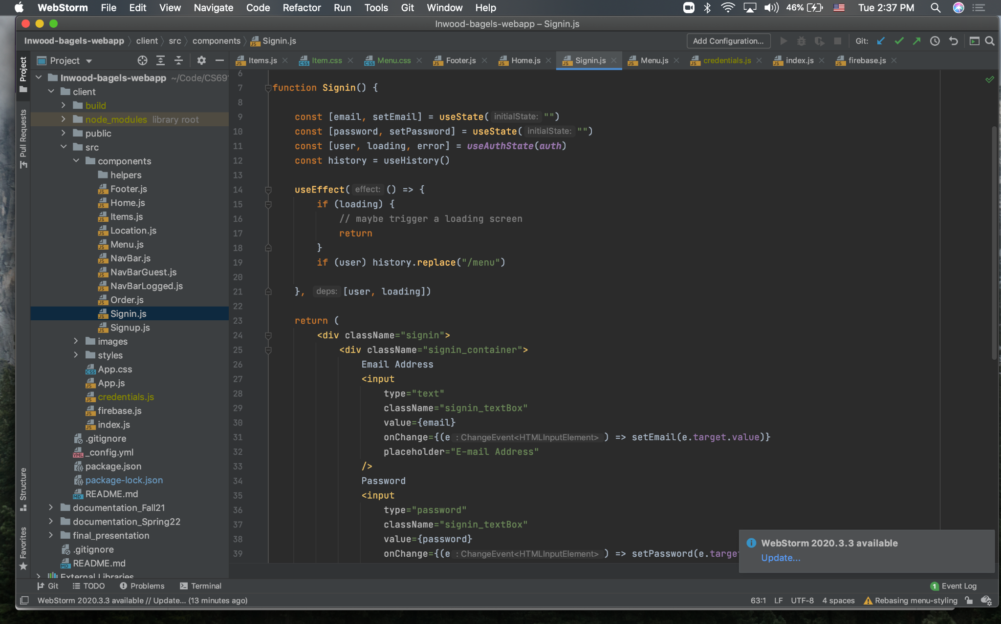
Code Examples

Slide 12
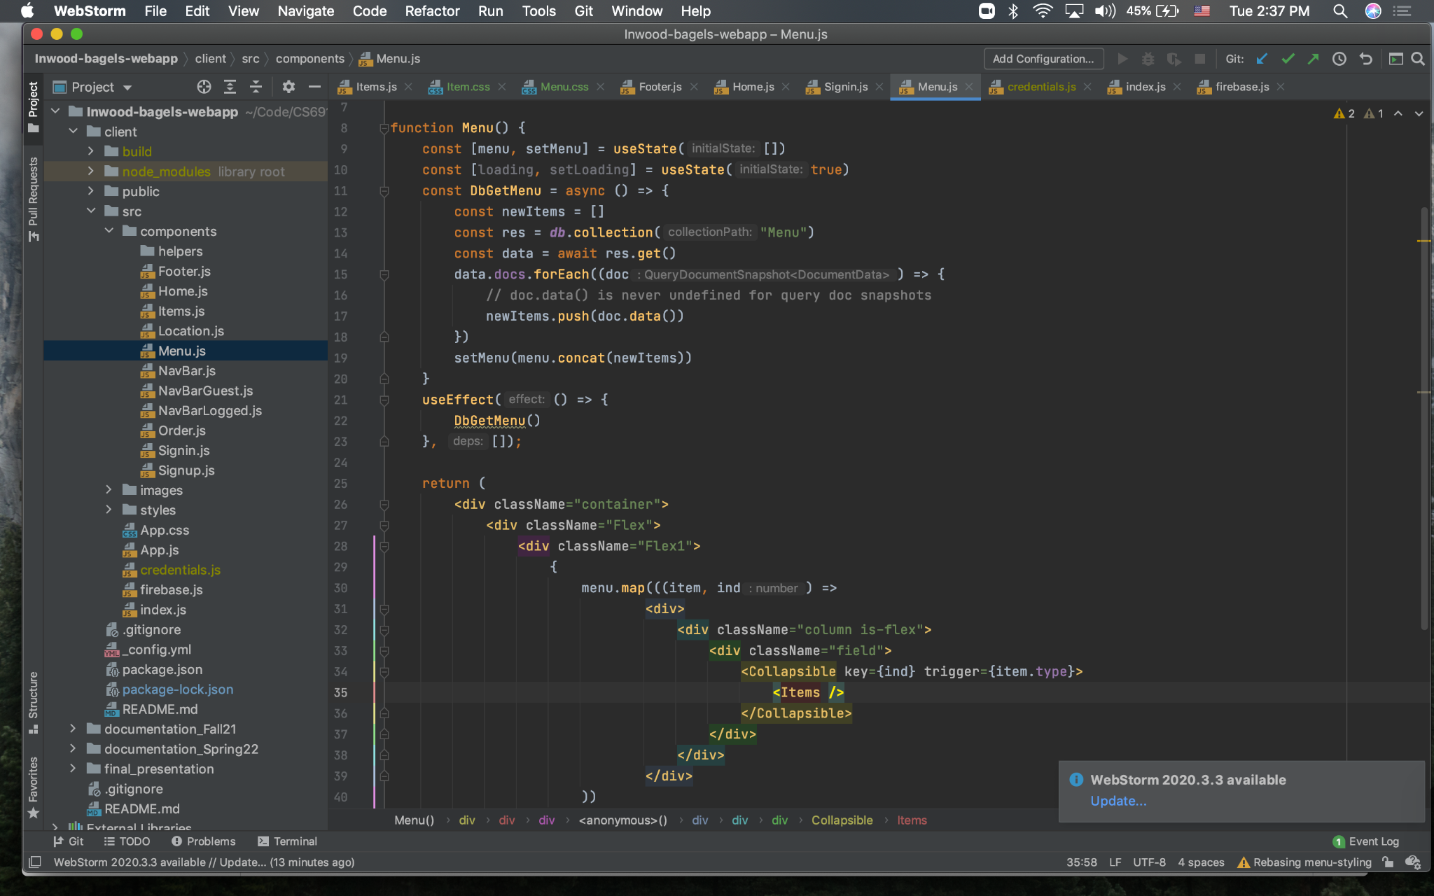
Code Examples

Slide 13
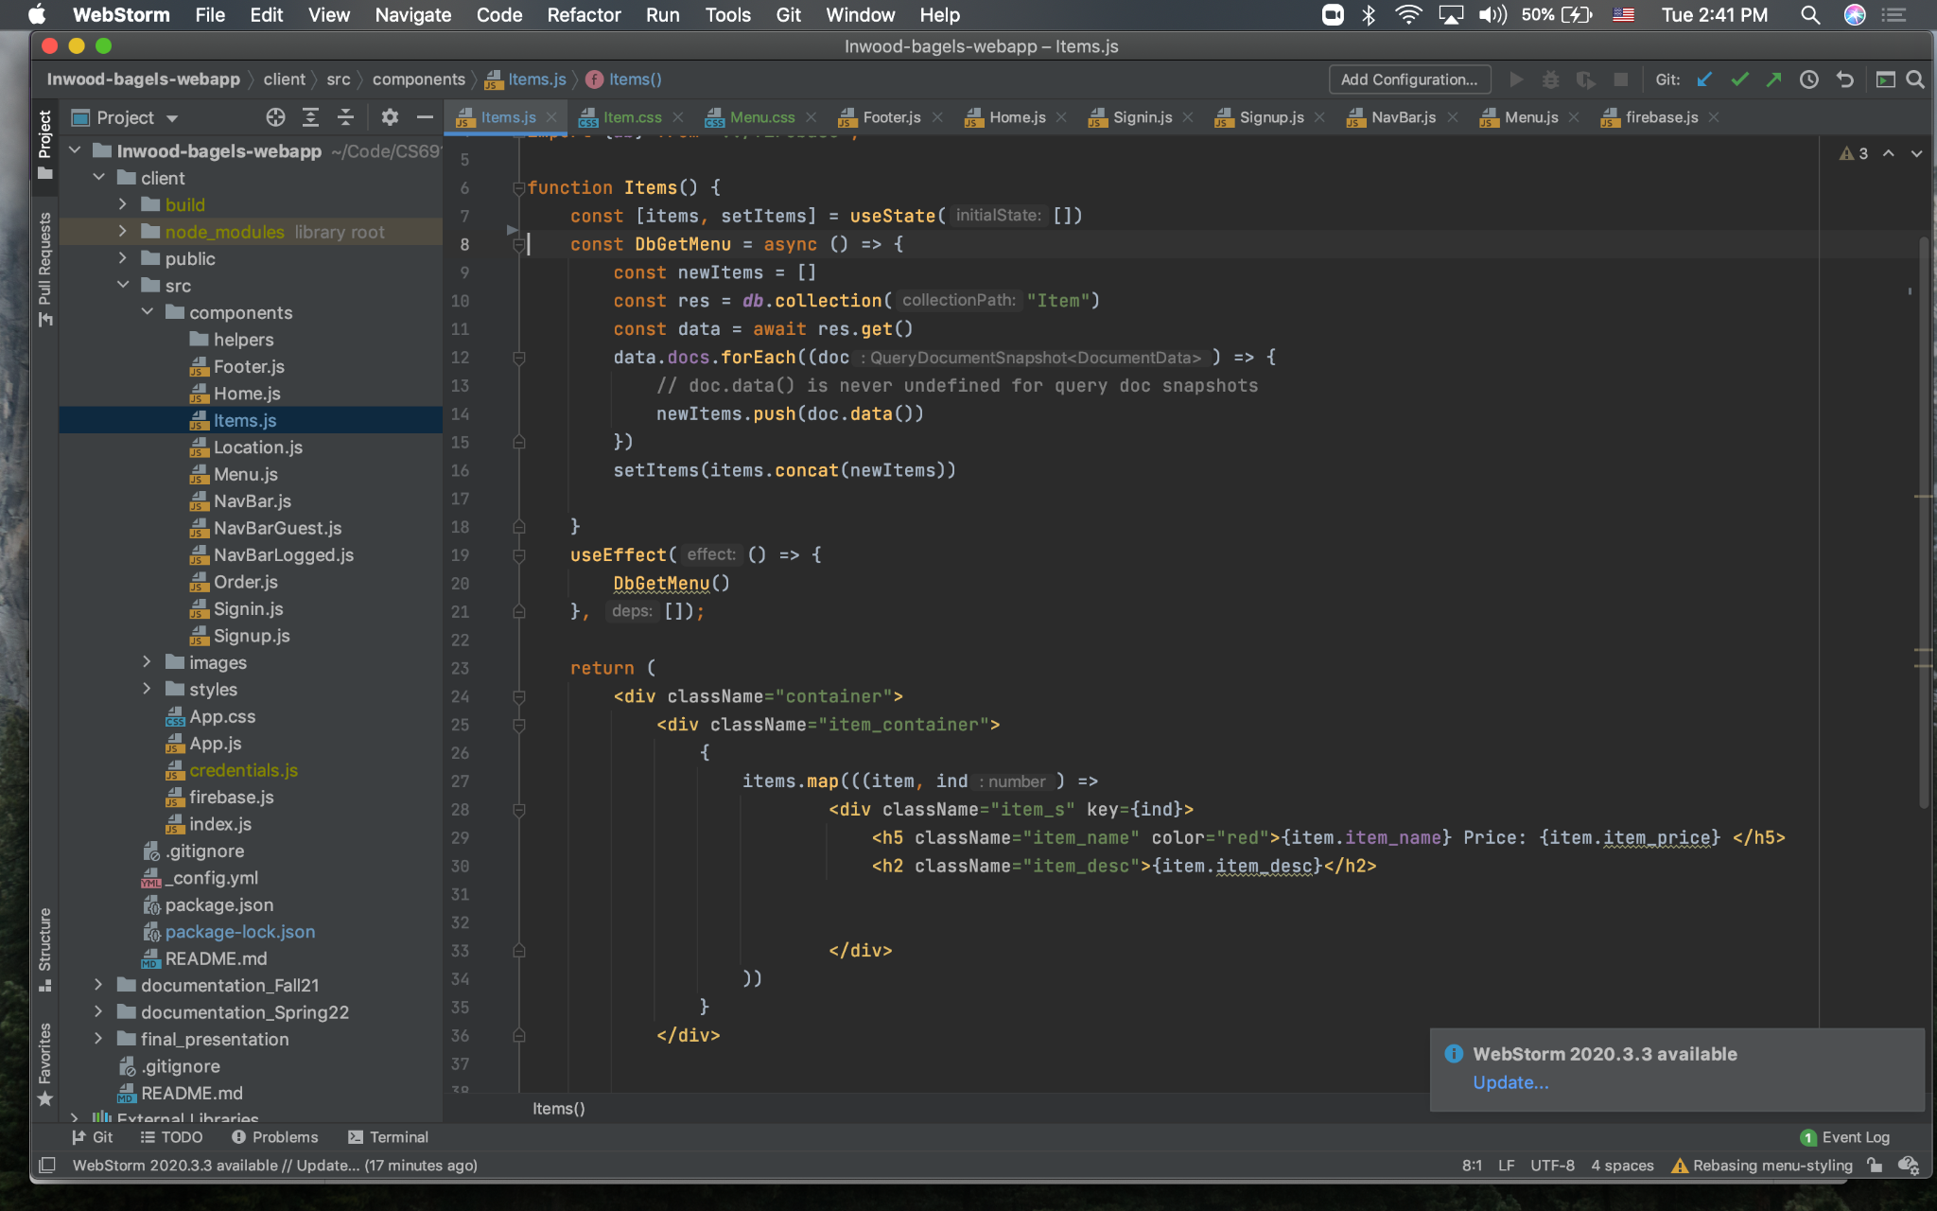
Code Examples

Slide 14
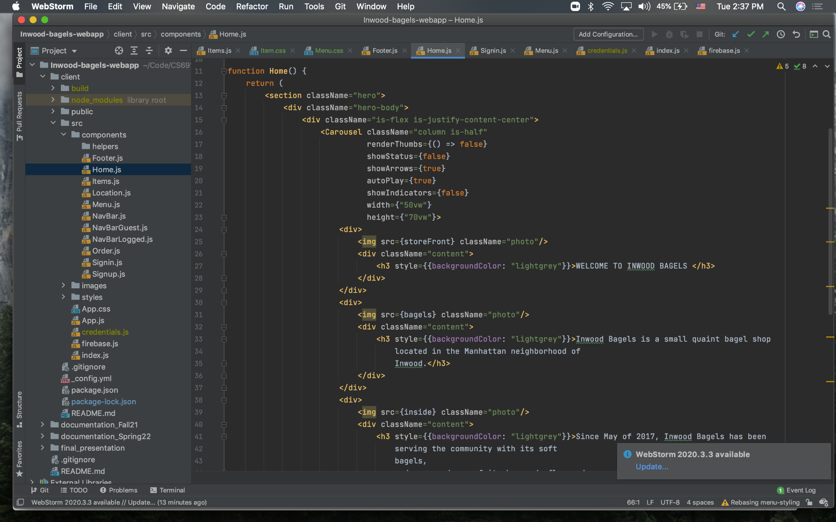
Code Examples

